Slide 1
Chapter 6.2
MATH 1550 - Precalculus

Slide 2
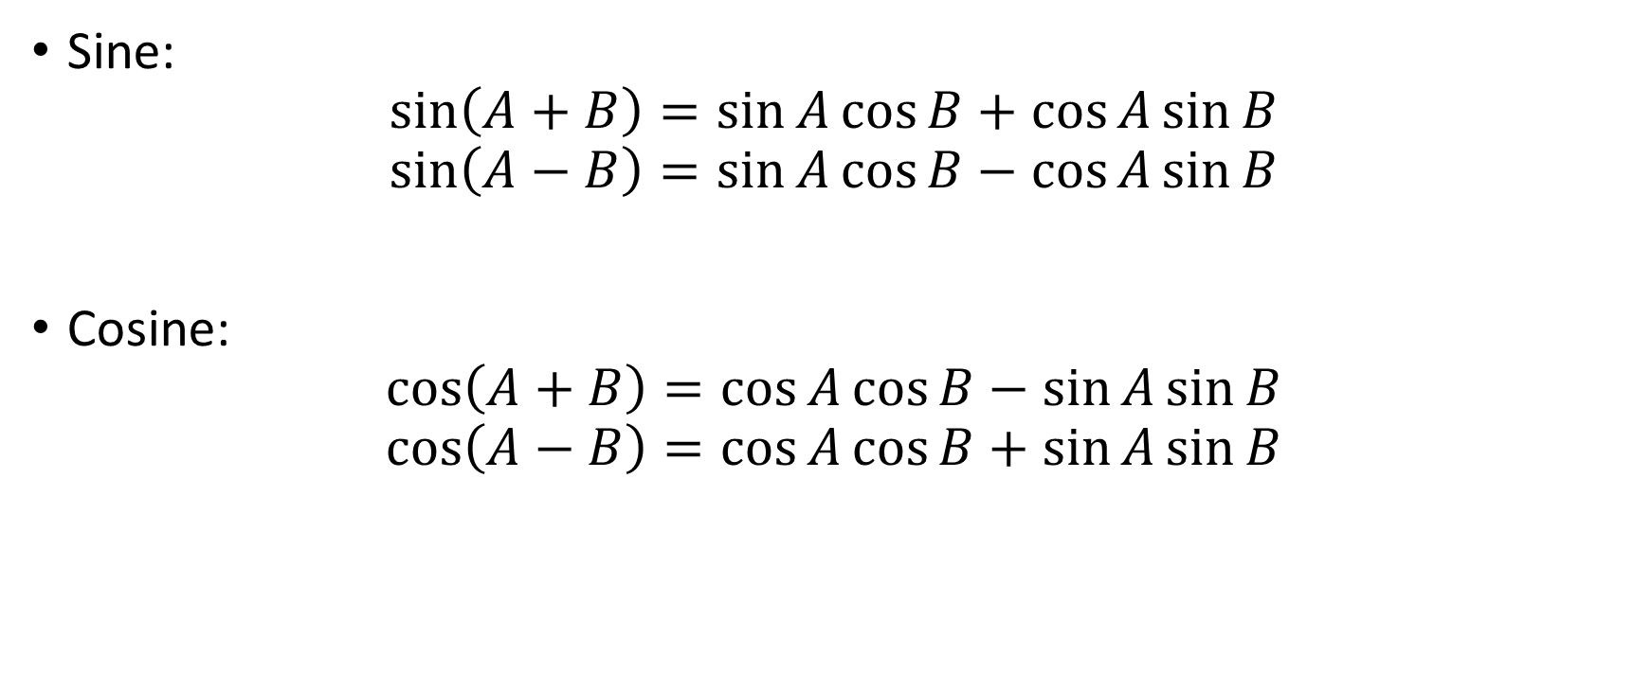
Sum and Difference Identities
Sine:
$$\sin\left(A+B\right)=\sin{A}\cos{B+\cos{A\sin{B}}}$$
$$\sin\left(A−B\right)=\sin{A}\cos{B−\cos{A\sin{B}}}$$
Cosine:
$$\cos\left(A+B\right)=\cos{A}\cos{B−\sin{A\sin{B}}}$$
$$\cos\left(A−B\right)=\cos{A}\cos{B+\sin{A\sin{B}}}$$

Slide 3
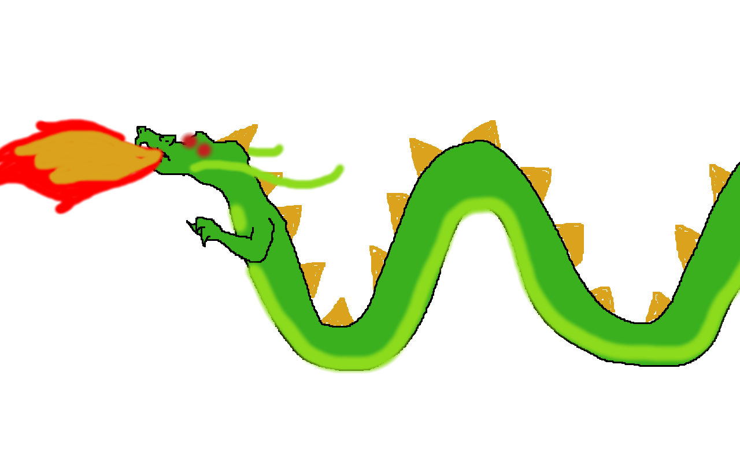



Extra Credit Opportunity
Draw a picture using trigonometric functions.
Must clearly state functions used.
Also must state (if applicable):
Amplitude, phase shift, vertical shift, and period of the graph.
Due Monday, October 30th , 2017 in class at 8 AM
3
$$−\frac{π}{2}$$
$$\frac{π}{2}$$

